Slide 1
What is logistic regression
It’s a classification algorithm that is used where the response variable is categorical . Logistic regression predicts probability, hence its output values lie between 0 and 1
Example:- yes or no
pass or fail

Slide 2
What function we use in logistic regression what is e and x in sigmoid function
Sigmoid function is used in logistic regression
y=1/1+epower-x
X= independent variable
e= natural logarithm base
e=2.718 is a constant value
Sigmoid function trying to convert the independent variable into expression of probability that ranges between 0 to1 respect to the dependednt variable
This the scenario of binary classification
All the data points will be in the range of 0 and 1 after we apply the logistic regression

Slide 3
Type of Logistic Regression: On the basis of the categories, Logistic Regression can be classified into three types: Binomial: In binomial Logistic regression, there can be only two possible types of the dependent variables, such as 0 or 1, Pass or Fail, etc. Multinomial: In multinomial Logistic regression, there can be 3 or more possible unordered types of the dependent variable, such as "cat", "dogs", or "sheep" Ordinal: In ordinal Logistic regression, there can be 3 or more possible ordered types of dependent variables, such as "low", "Medium", or "High".

Slide 4
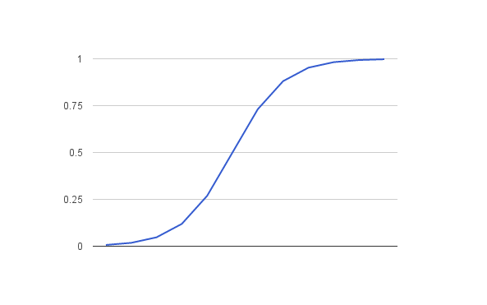
0=No probability of occurrence 1=certain possibility of occurrence

Slide 5
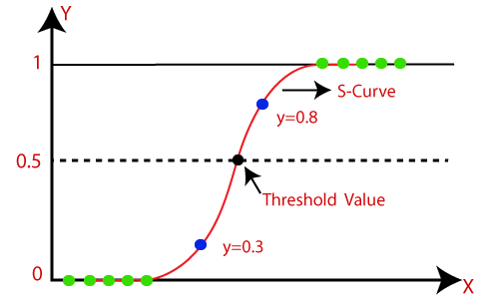

Slide 6
Pros
Simple and efficient
It provides probability score for observation

Slide 7
cons
Doesn’t handle large number of categorical feature variables well
It requires transformation of non linear feature

Slide 8
Gmail & other inboxes identifying ‘Spam Emails’ Understanding the possibility of getting admission into a University
Application of logistic regression

